Slide 1
70-533 :
Implementing Microsoft Azure Infrastructure Solutions

Slide 2
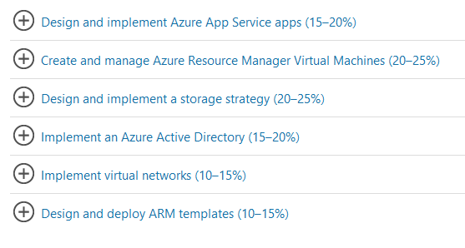
70-533 : Implementing Microsoft Azure Infrastructure Solutions

Slide 3
What is Azure Active Directory?
Azure Active Directory (Azure AD) is Microsoft’s multi-tenant cloud based directory and identity management service.
For IT Admins, Azure AD provides an affordable, easy to use solution to give employees and business partners single sign-on (SSO) access to thousands of cloud SaaS Applications like Office365, Salesforce.com, DropBox, and Concur.
Azure AD also includes a full suite of identity management capabilities including multi-factor authentication, device registration, self-service password management, self-service group management, privileged account management, role based access control, application usage monitoring, rich auditing and security monitoring and alerting. These capabilities can help secure cloud based applications, streamline IT processes, cut costs and help ensure that corporate compliance goals are met.
AD can be integrated with an existing Windows Server Active Directory, giving organizations the ability to leverage their existing on-premises identity investments to manage access to cloud based SaaS applications.
If you are an Office365, Azure or Dynamics CRM Online customer, you might not realize that you are already using Azure AD. Every Office365, Azure and Dynamics CRM tenant is actually already an Azure AD tenant. Whenever you want you can start using that tenant to manage access to thousands of other cloud applications Azure AD integrates with!

Slide 4
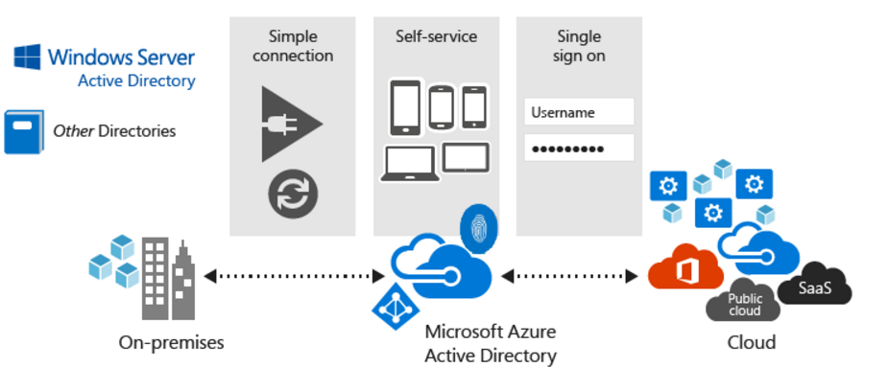
Quickly adopt cloud services, providing employees and partners with an easy single-sign on experience powered by Azure AD’s fully automated SaaS app access management and provisioning services capabilities.
Empower employees with access to world class cloud apps and self-service capabilities from wherever they need to work on the devices they love to use.

Slide 5
Integrate an Azure with Existing Directory

Slide 6
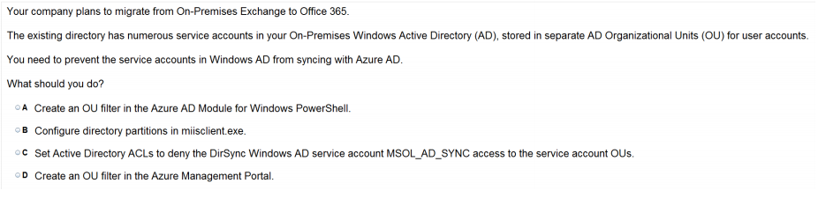

Slide 7
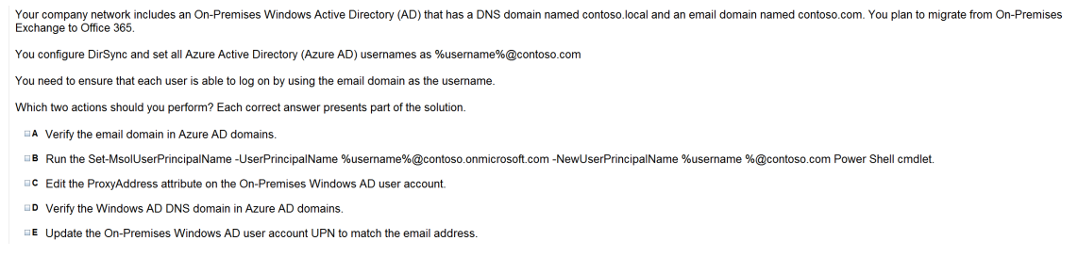

Slide 8
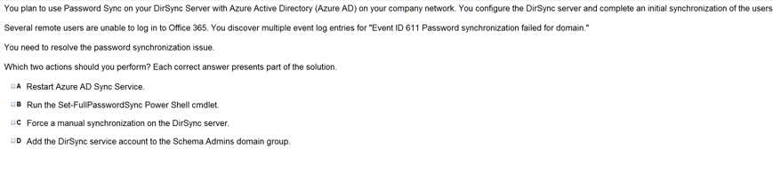

Slide 9
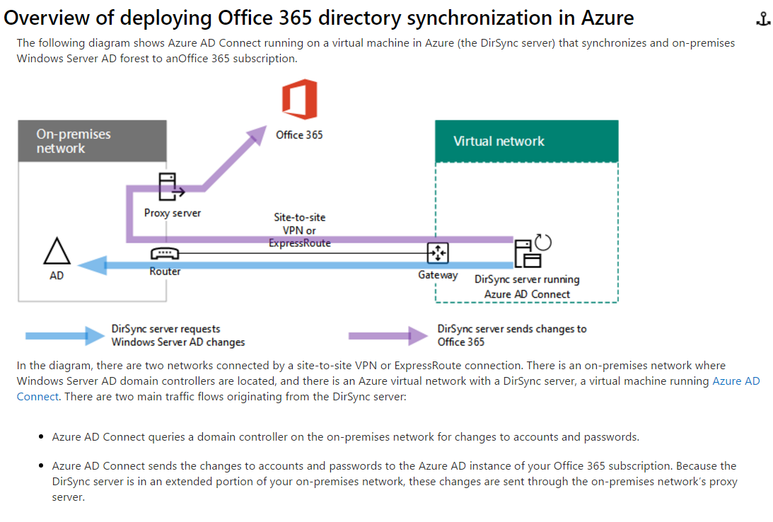

Slide 10
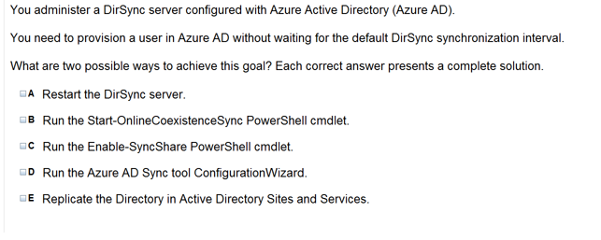

Slide 11
Explanation: If you don’t want to wait for the recurring synchronizations that occur every three hours, you can force directory synchronization at any time.
B: Force directory synchronization using Windows PowerShell You can use the directory synchronization Windows PowerShell cmdlet to force synchronization. The cmdlet is installed when you install the Directory Sync tool.On the computer that is running the Directory Sync tool, start PowerShell, type Import-Module DirSync, and then press ENTER.TypeStart-OnlineCoexistenceSync, and then press ENTER.
D: Azure Active Directory Sync Services (AAD Sync) In September 2014 the Microsoft Azure AD Sync tool was released. This changed how manual sync requests are issued.To perform a manual update we now use the DirectorySyncClientCmd.exe tool. The Delta and Initial parameters are added to the command to specify the relevant task.This tool is located in: C:\Program Files\Microsoft Azure AD Sync\Bin You can use the directory synchronization Windows PowerShell cmdlet to force synchronization. The cmdlet is installed when you install the Directory Sync tool.On the computer that is running the Directory Sync tool, start PowerShell, type Import-Module DirSync, andthen press ENTER.Type Start-OnlineCoexistenceSync, and then press ENTER.

Slide 12
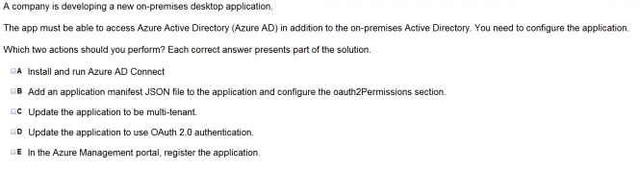

Slide 13
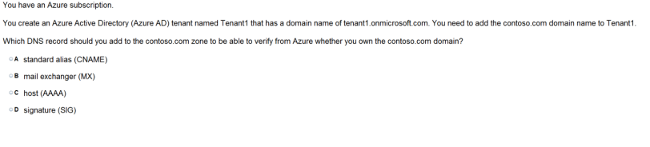

Slide 14
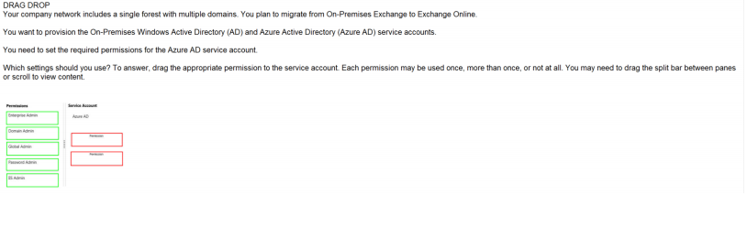
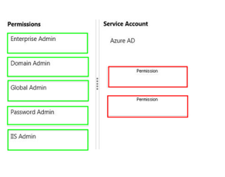

Slide 15
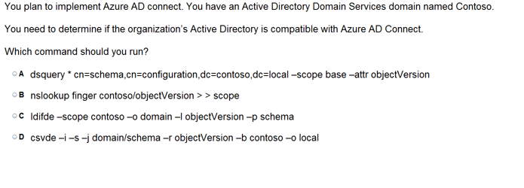

Slide 16
Configure the Application Panel

Slide 17
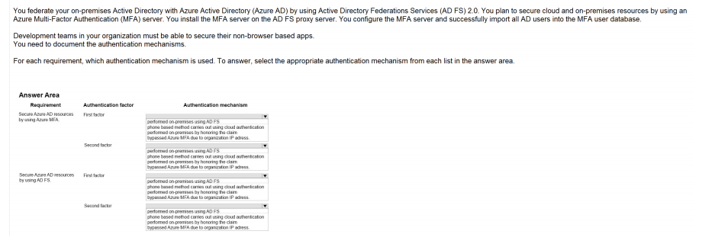
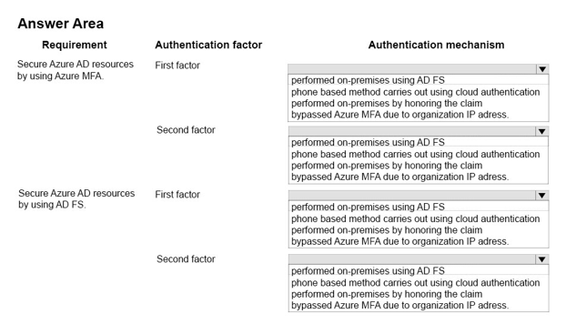
Ans =

Slide 18
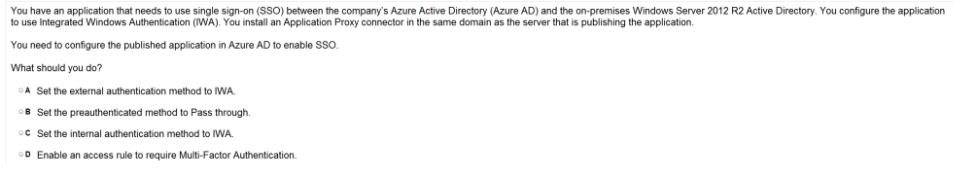

Slide 19
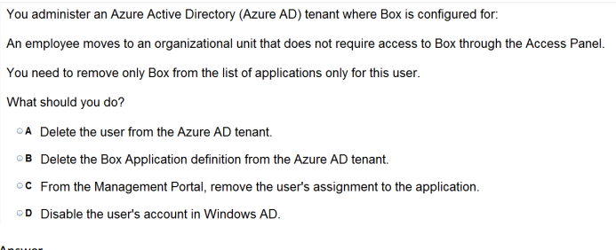

Slide 20
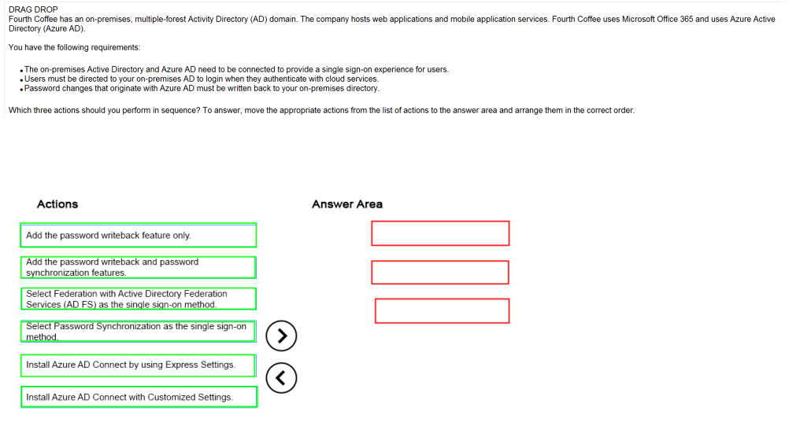
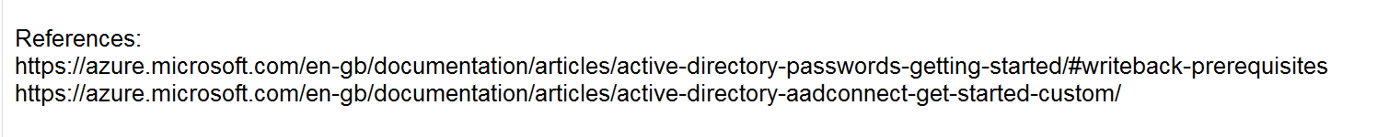
Ans =

Slide 21
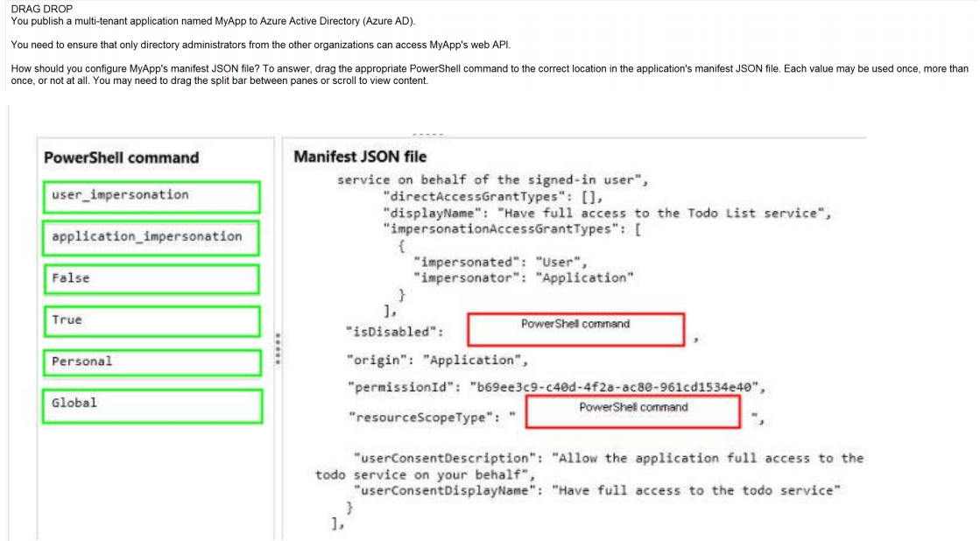
Ans =

Slide 23
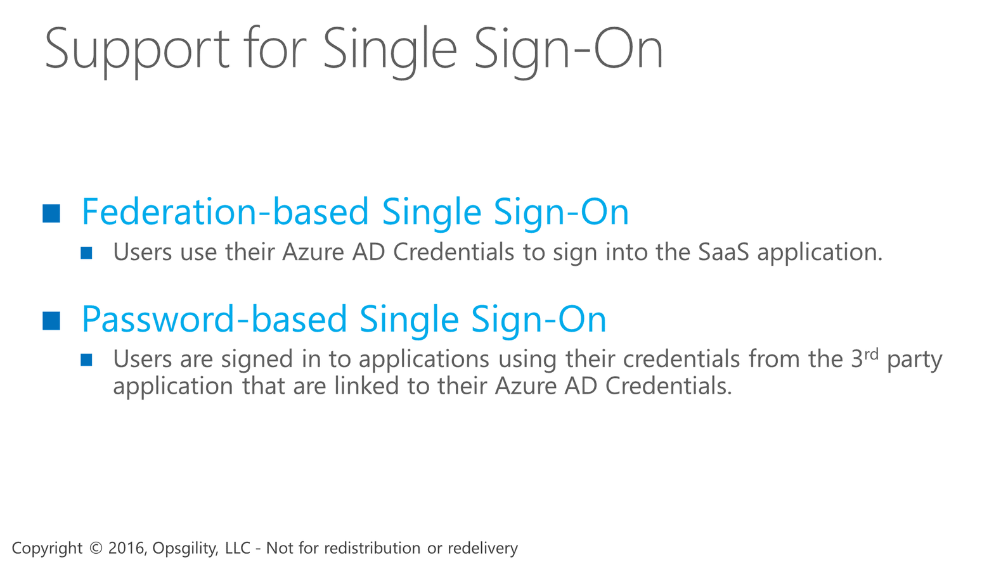

Support for Single Sign-On
Notes:
The support for single sign-on to 3rd party applications comes in two forms.
The first is Federation-based, where users are signed-in to their applications using their Azure AD credentials.
The other is Password-based, where users are signed in to their applications using their own personal credentials from the 3rd party application. In this scenario, the user’s credentials are securely stored in Azure AD and when the user accesses the application, those credentials are provided to the application to sign the user in.

Slide 24
Support for Single Sign-On
Notes:
The support for single sign-on to 3rd party applications comes in two forms.
The first is Federation-based, where users are signed-in to their applications using their Azure AD credentials.
The other is Password-based, where users are signed in to their applications using their own personal credentials from the 3rd party application. In this scenario, the user’s credentials are securely stored in Azure AD and when the user accesses the application, those credentials are provided to the application to sign the user in.

Slide 25
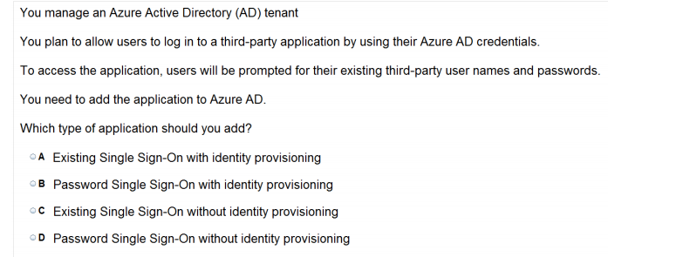
Explanation: * Azure AD supports two different modes for single sign-on: / Federation using standard protocols Configuring Federation-based single sign-on enables the users in your organization to be automatically signed in to a third-party SaaS application by Azure AD using the useraccount information fromAzure AD. / Password-based single sign-on * Support for user provisioning User provisioning enables automated user provisioning and deprovisioning of accounts in thirdparty SaaS applications from within the Azure Management Portal, using your Windows Server Active Directory or Azure AD identity information. When a user is given permissions in Azure AD for one of these applications, an account can be automatically created (provisioned) in the target SaaSapplication.

Slide 26
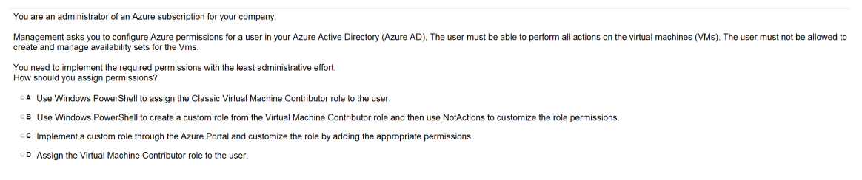

Slide 27
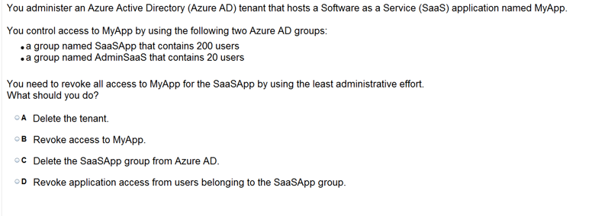

Slide 28
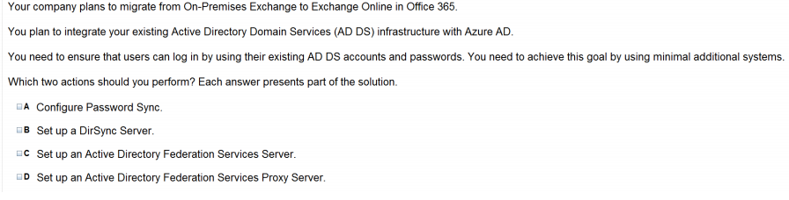

Slide 29
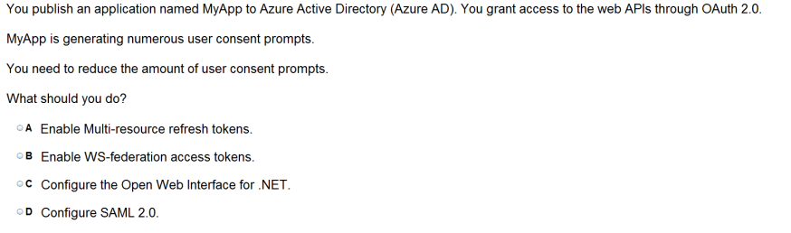

Slide 30
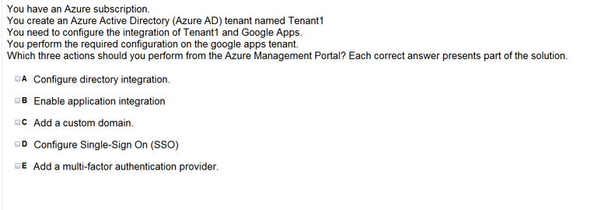

Slide 31
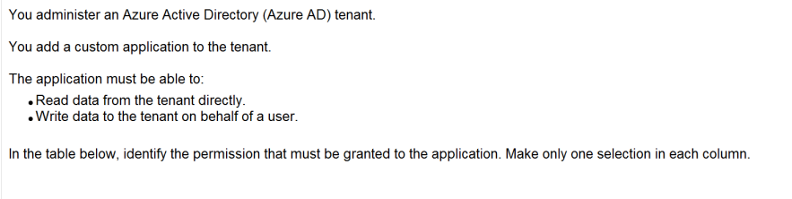
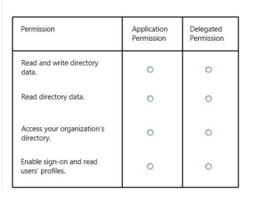
Ans =

Slide 32
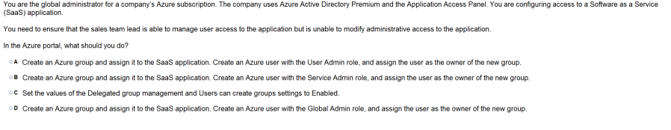

Slide 33
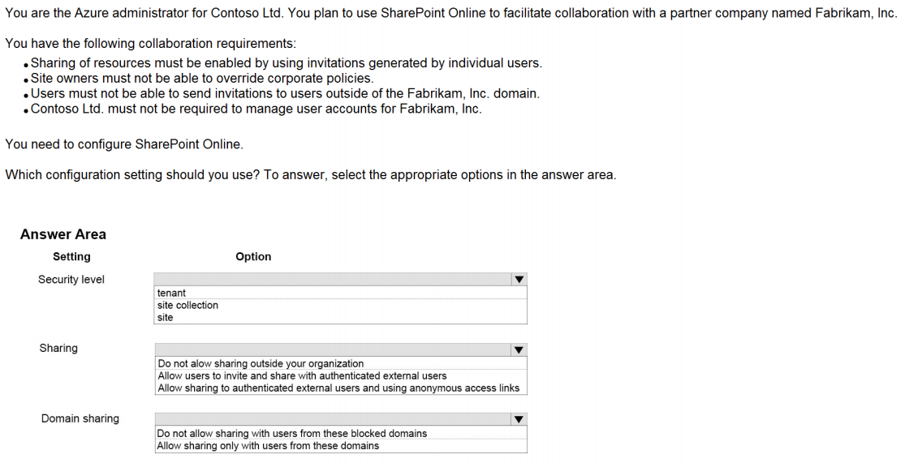
Ans =

Slide 34
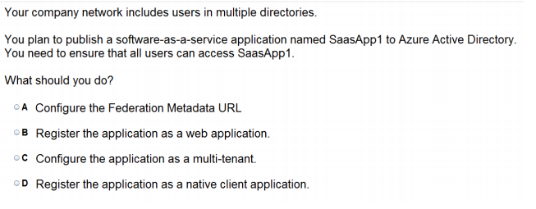
The term "software multitenancy" refers to a software architecture in which a single instance of software runs on a server and serves multiple tenants. A tenant is a group of users who share a common access with specific privileges to the software instance
Explanation: * When you get deeper into using Windows Azure Active Directory, you’ll run into new terminology. For instance, is called "directory" is also referred to as a Windows Azure AD Tenant or simply as "tenant." This stems from the fact that WAAD ()Windows Azure Active Directory is a shared service for many clients. In this service, every client gets its own separate space for which the client is the tenant. In the case of WAAD this space is a directory. This might be a little confusing, because you can create multiple directories, in WAAD terminology multiple tenants, even though you are a single client. * Multitenant Applications in Azure A multitenant application is a shared resource that allows separate users, or "tenants," to view the application as though it was their own. A typical scenario that lends itself to a multitenant application is one in which all users of the application may wish to customize the user experience but otherwise have the same basic business requirements. Examples of large multitenant applications are Office365, Outlook.com, and visualstudio.com.

Slide 35
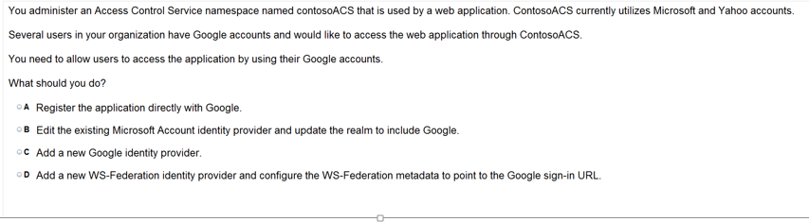
https://docs.microsoft.com/en-us/azure/active-directory/active-directory-saas-google-apps-tutorial

Slide 36
Integrate the App with Azure AD

Slide 37
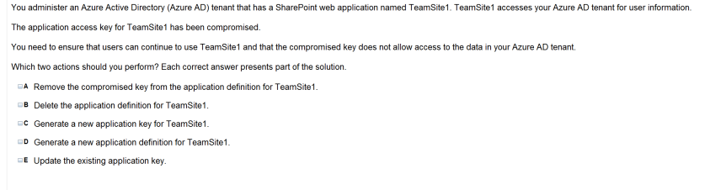

Slide 38
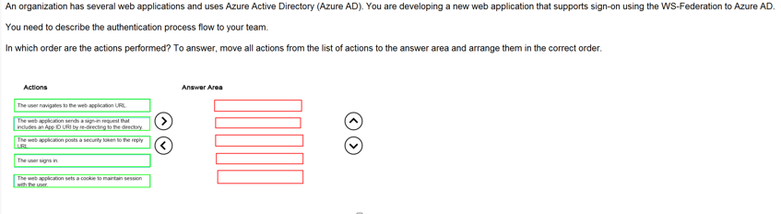
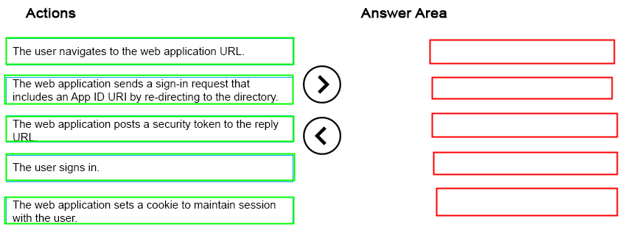
Ans =

Slide 39
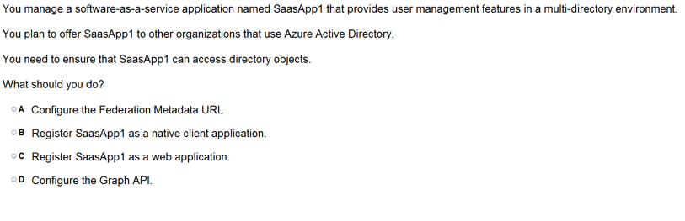
REST APIendpoints.Applications can use the Graph API to perform create, read, update, and delete (CRUD) operationson directory data and objects. For example, the Graph API supports the following common operations for a user object: / Create a new user in a directory / Geta user’s detailed properties, such as their groups / Update a user’s properties, such as their location and phone number, or change their password / Check a user’s group membership for role-based access / Disable a user’s account or delete it entirely

Slide 40
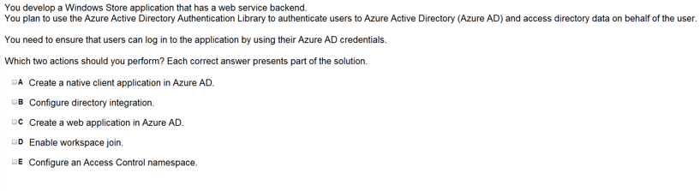

Slide 41
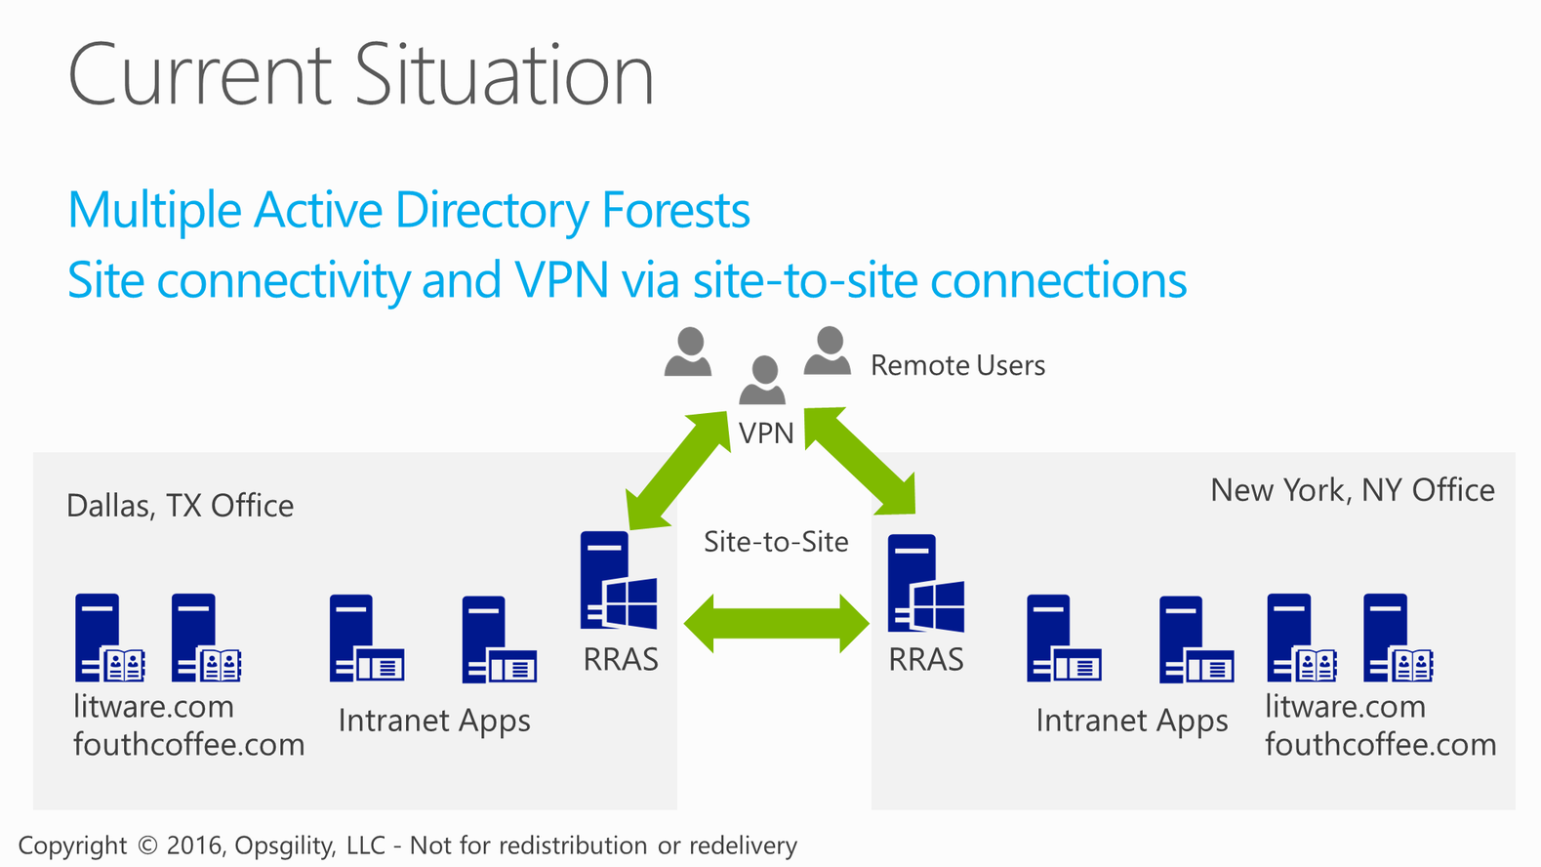
Current Situation

Slide 42
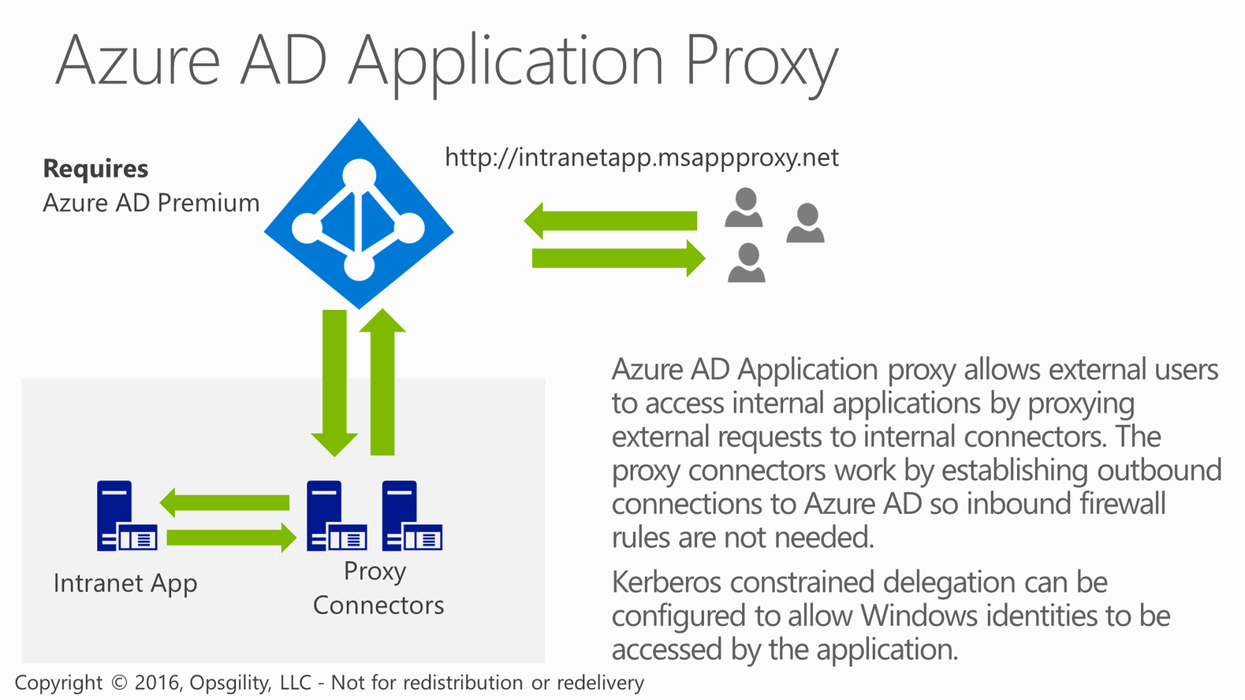
Azure AD Application Proxy

Slide 43
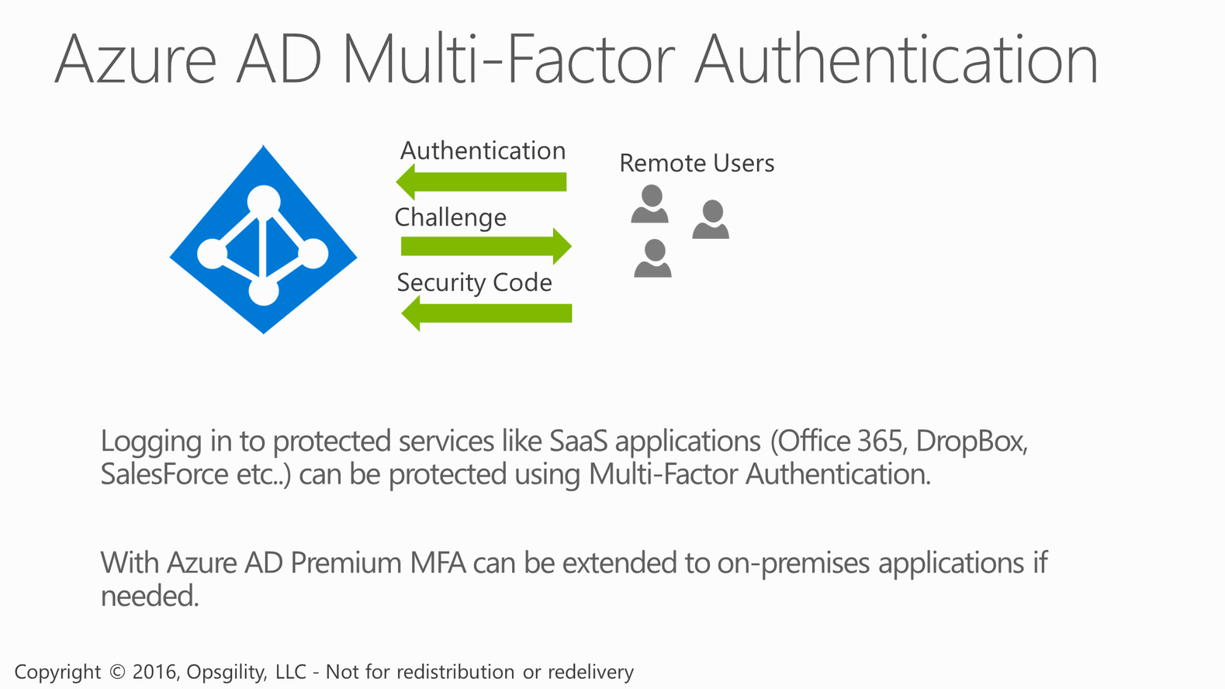
Azure AD Multi-Factor Authentication

